Slide 1

Operation Analytics and Investigating Metrics Spike
PROJECT 3

Slide 2
Project Description
This project is about Operation Analytics and investigating Metrics Spikes. Which consists two case studies. First is Operation Analytics and second is Investigating metrics spikes
As the Lead Data Analyst at a company like Microsoft, my role is to harness the power of data to drive improvements in our operations and uncover valuable insights that guide strategic decisions
By utilizing advanced SQL skills I derived some insightful answers to these questions on a daily basis
A key focus of my role is investigating metric spikes and changes in key performance indicators, such as user engagement and fluctuations in sales
Through analysis and interpretation of data, I contribute to enhancing our operations, optimizing resource allocation, and refining our strategies

Slide 3
Approach
To get the answers to the questions I used MySQL workbench 8.0 to write SQL queries and perform analysis on the given dataset.
I understood the dataset first and then executed SQL queries to derive insightful outcomes from the data to enhance the decision making and performance of the company
After getting desirable and accurate results I generated a thorough report in Power point to make it understandable and effective.

Slide 4
Tech stack used
MySQL was used to run the queries.
Because MySQL workbench is a powerful and widely used tool for database design, database management and data analysis. It offers variety tools for data analysis, data management which align well with tasks of this project.
Power point to generate report

Slide 5
Insights
Case Study 1: Job Data Analysis
Tasks –
Calculate the number of jobs reviewed per hour for each day in November 2020
Calculate the 7-day rolling average of throughput (number of events per second)
Calculate the percentage share of each language in the last 30 days
Identify duplicate rows in the data
Case Study 2: Investigating Metric Spike
Tasks –
Measure the activeness of users on a weekly basis
Analyze the growth of users over time for a product
Analyze the retention of users on a weekly basis after signing up for a product
Measure the activeness of users on a weekly basis per device
Analyze how users are engaging with the email service

Slide 6
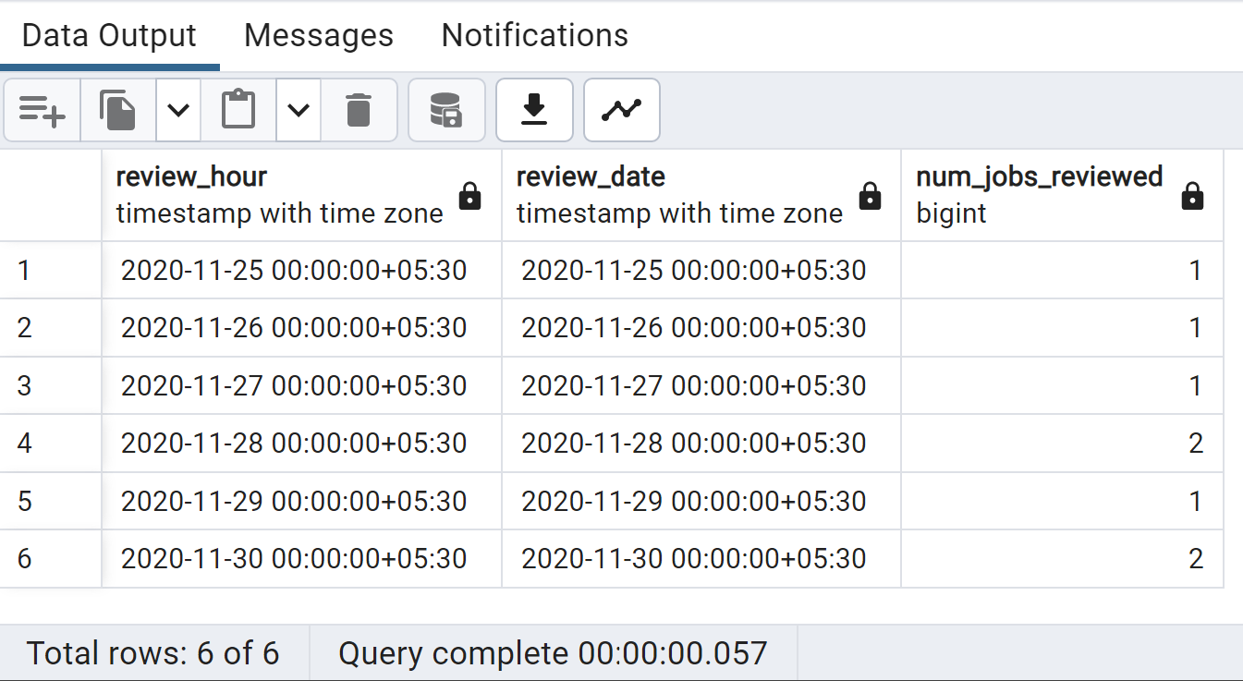
Case Study 1: Job Data Analysis 1) Jobs Reviewed Over Time - Calculate the number of jobs reviewed per hour for each day in November 2020
SELECT
DATE_TRUNC('hour', ds) AS review_hour,
DATE_TRUNC('day', ds) AS review_date,
COUNT(*) AS num_jobs_reviewed
FROM
job_data
WHERE
DATE_TRUNC('month', ds) = '2020-11-01'::DATE
GROUP BY
DATE_TRUNC('hour', ds),
DATE_TRUNC('day', ds)
ORDER BY
review_date,
review_hour;

Slide 7
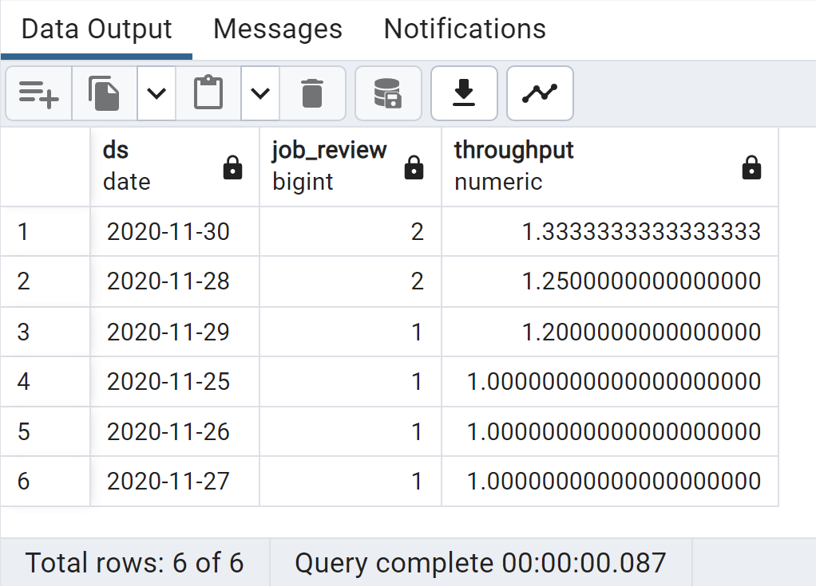
2) Throughput Analysis: Calculate the 7-day rolling average of throughput (number of events per second)
WITH DAILY_METRIC AS (
SELECT ds,
COUNT(job_id) AS job_review
FROM
job_data
GROUP BY
ds)
SELECT
ds,
job_review,
AVG(job_review) OVER (ORDER BY ds ROWS BETWEEN
6 PRECEDING AND CURRENT ROW) AS throughput
FROM
DAILY_METRIC
ORDER BY
throughput DESC;

Slide 8
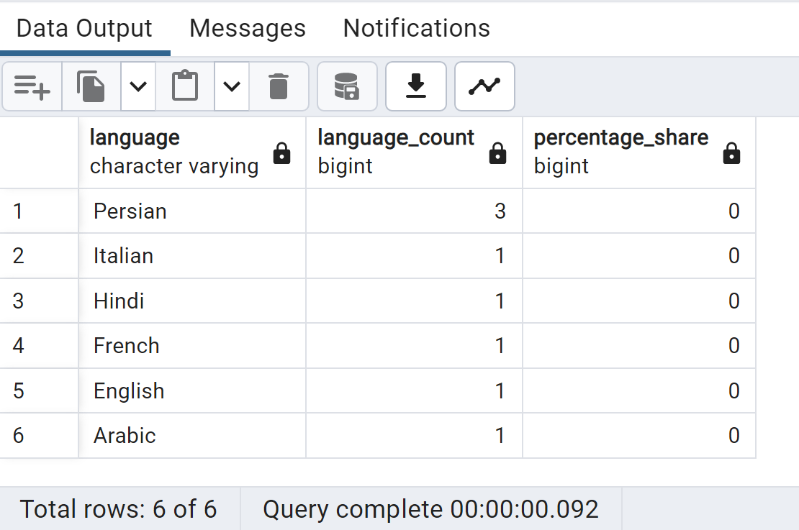
3) Language Share Analysis: Calculate the percentage share of each language in the last 30 days
SELECT
language,
COUNT(language) AS language_count,
(COUNT(language) / (SELECT COUNT(*)
FROM job_data)) * 100 AS percentage_share
FROM job_data
GROUP BY language
ORDER BY language DESC;

Slide 9
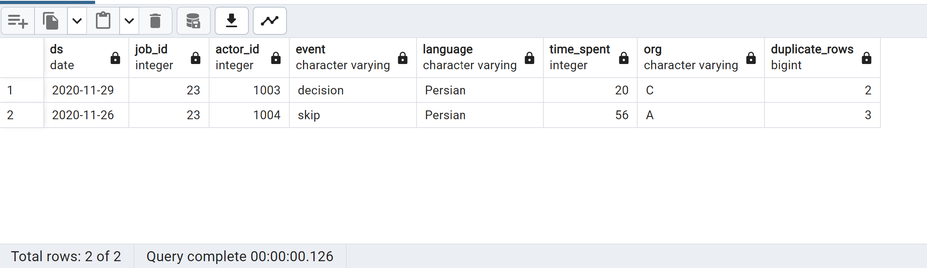
4) Duplicate Rows Detection: Identify duplicate rows in the data
SELECT *
FROM (
SELECT *,
ROW_NUMBER() OVER (PARTITION BY JOB_ID)
AS DUPLICATE_ROWS
FROM JOB_DATA
) AS A_R
WHERE DUPLICATE_ROWS > 1;

Slide 10
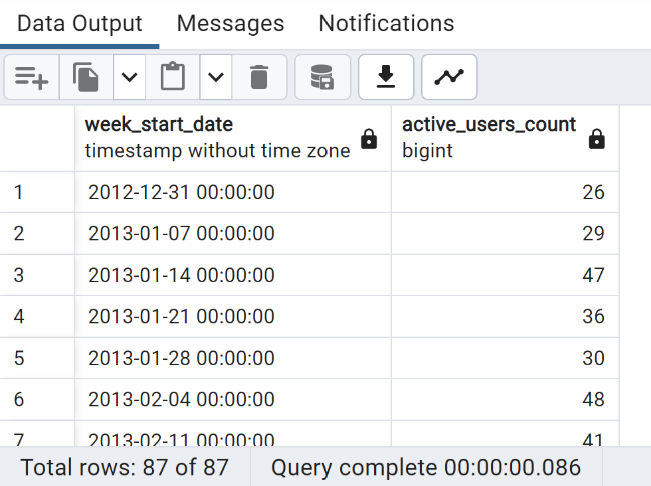
Case Study 2: Investigating Metric Spike 1) Weekly User Engagement: Measure the activeness of users on a weekly basis
SELECT
DATE_TRUNC('week', created_at) AS week_start_date,
COUNT(DISTINCT user_id) AS active_users_count
FROM
users
GROUP BY
week_start_date
ORDER BY
week_start_date;

Slide 11
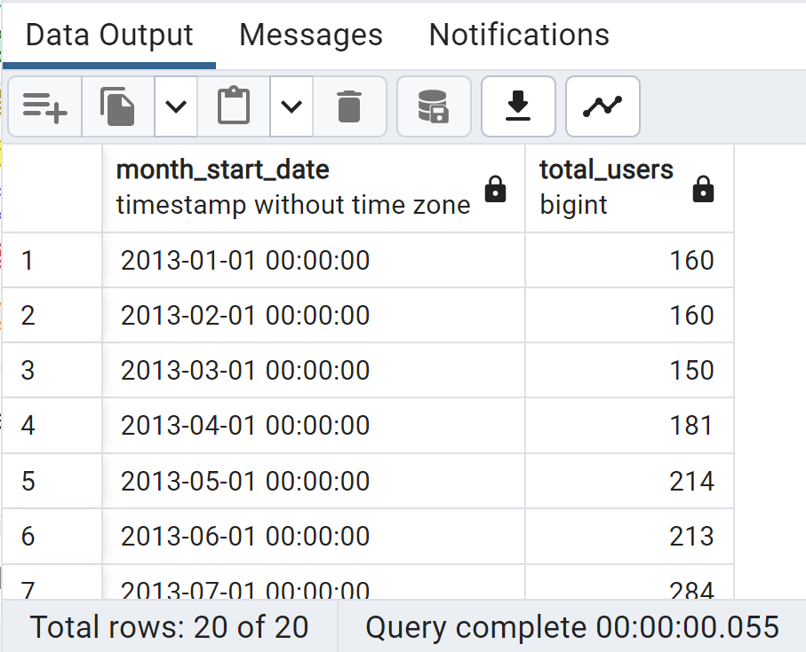
2) User Growth Analysis: Analyze the growth of users over time for a product
SELECT
DATE_TRUNC('month', created_at) AS month_start_date,
COUNT(DISTINCT user_id) AS total_users
FROM
users
GROUP BY
month_start_date
ORDER BY
month_start_date;

Slide 12
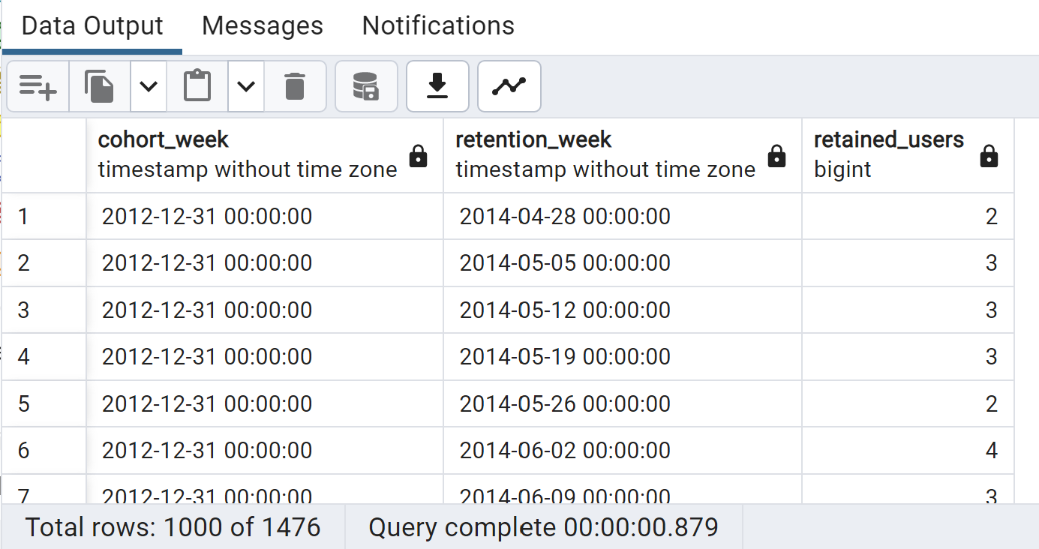
3) Weekly Retention Analysis: Analyzing the retention of users on a weekly basis after signing up for a product.
WITH user_signups AS (
SELECT
user_id,
DATE_TRUNC('week', created_at) AS signup_week
FROM
users),
user_activity AS (
SELECT
user_id,
DATE_TRUNC('week', occurred_at) AS activity_week
FROM
events)
SELECT
us.signup_week AS cohort_week,
ua.activity_week AS retention_week,
COUNT(DISTINCT ua.user_id) AS retained_users
FROM
user_signups us
LEFT JOIN
user_activity ua ON us.user_id = ua.user_id AND ua.activity_week >= us.signup_week
GROUP BY
us.signup_week, ua.activity_week
ORDER BY
us.signup_week, ua.activity_week;

Slide 13
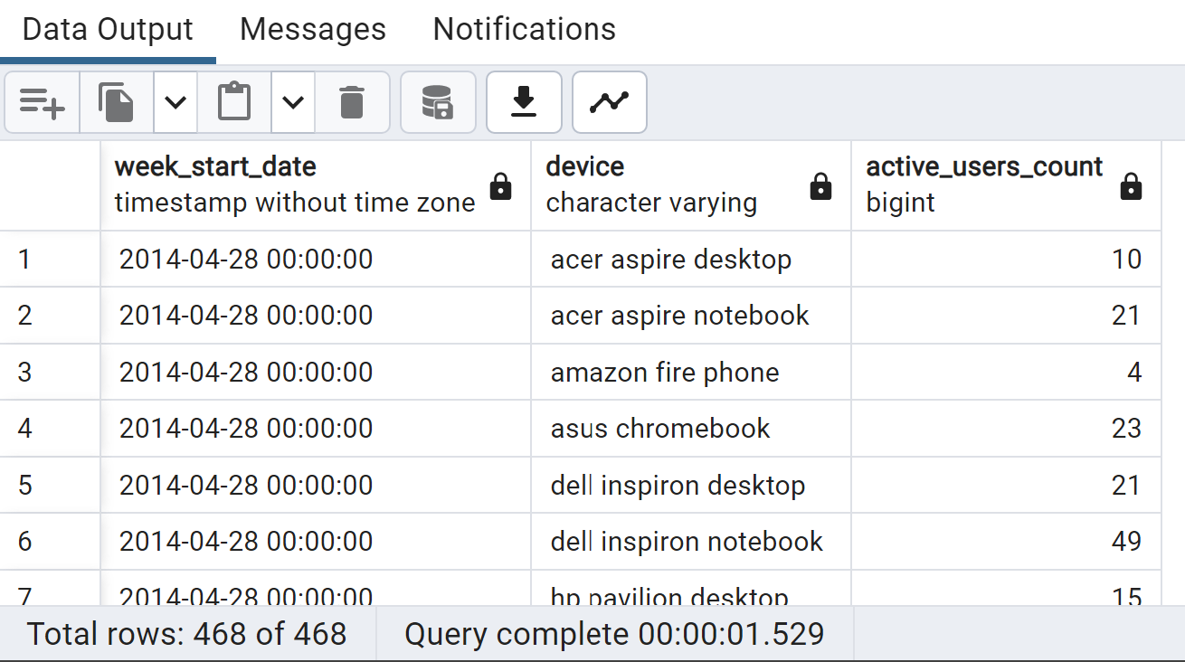
4) Weekly Engagement Per Device: Measuring the activeness of users on a weekly basis per device.
SELECT
DATE_TRUNC('week', e.occurred_at) AS week_start_date,
e.device,
COUNT(DISTINCT e.user_id) AS active_users_count
FROM
events e
GROUP BY
week_start_date, e.device
ORDER BY
week_start_date, e.device;

Slide 14
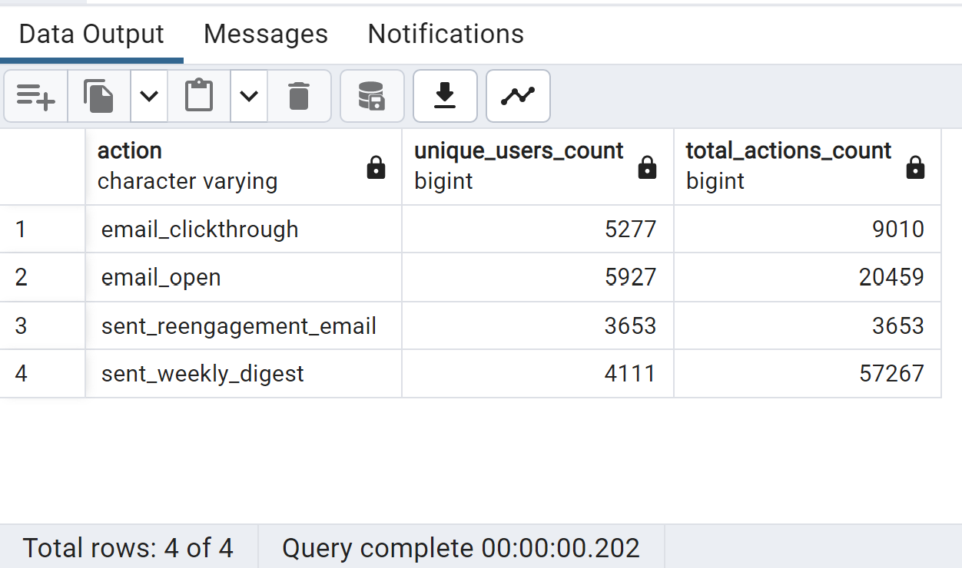
5) Email Engagement Analysis: Analyzing how users are engaging with the email service
SELECT
action,
COUNT(DISTINCT user_id) AS unique_users_count,
COUNT(*) AS total_actions_count
FROM
email_events
GROUP BY
action
ORDER BY
action;

Slide 15
Result
The project was very challenging and helped to learn a lot of new skills and concepts while working on a project
Gained real life practical experience to execute my SQL skills
Also helped to understand to present the data in a better way to make it more understandable

